Slide 1

Seafood HACCP Alliance
Segment Two Course
Course Number:
Course Location:
Course Date:
AFDO Region:
Instructor:

Slide 2
AGENDA (SHA Segment 2 Course)
PART 1: Lecture and Discussion
      FDA Seafood HACCP Regulation
      Seafood Safety Hazards & Controls
      Developing a HACCP Program
PART 2: Course Work Assignment
      Team Work Groups & Presentations

Slide 3
Purpose of this Training
Individuals who complete this course will meet
the training requirement of the FDA Seafood HACCP regulation and can do the following:
  Conduct a Hazard Analysis
  Develop a HACCP Plan for seafood products as required by the FDA regulation
  Reassess or modify a HACCP Plan as necessary and/or required by the FDA regulation
  Review HACCP Plan records as required by the FDA regulation

Slide 4
Expectations for Training
Seafood HACCP Alliance courses provide:
A basic introduction to the HACCP regulatory requirements for the processing of fish and fishery products.
Instructions and exercises to help learn how to use the seafood HACCP Guidance manual (FDA Guide) to conduct a Hazard Analysis and develop a HACCP Plan.
Receive explanations and examples for how to monitor the required Sanitation Control Procedures.

Slide 5

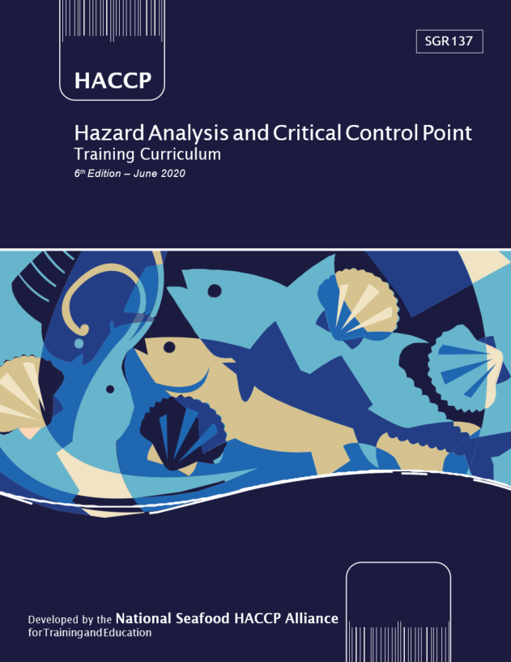
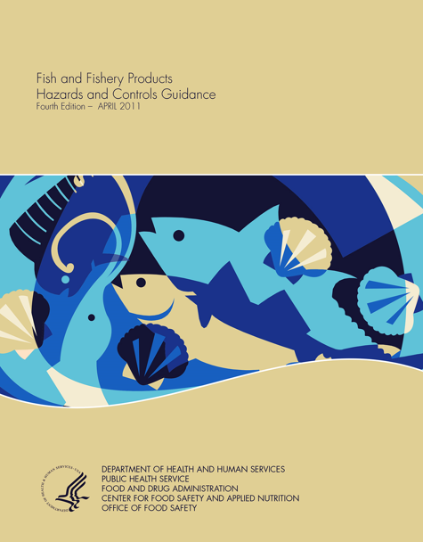
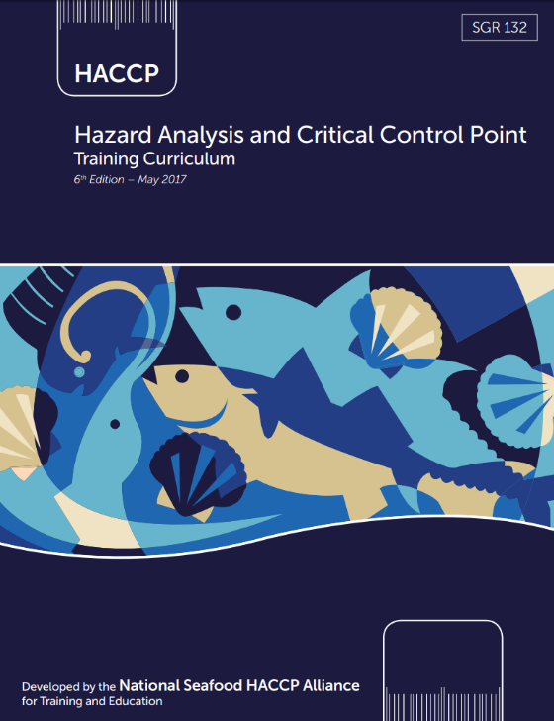
SHA Training Materials
SHA Curriculum
FDA GUIDE
GOLD BOOK
BLUE BOOK
GOLD BOOK
BLUE BOOK

Slide 6

FDA Seafood HACCP Regulation
21 CFR Part 123
https://www.fda.gov/food/hazard-analysis-critical-control-point-haccp/seafood-haccp

Slide 7


FDA Seafood HACCP Regulation
21 CFR Part 123
Any fish or fishery products processed or imported in violation of this regulation can be considered adulterated and subject to regulatory action
A processor is any person engaged in commercial, custom or institutional processing of fish or fishery products either in the U.S. or in a foreign country
An importer is the U.S. owner/consignee or the U.S. agent/representative of the foreign owner/consignee at the time of the product entry into the United States.
AD1 - 1
CHP12:185

Slide 8
What Does Processing Include?
Processing means:
Handling, storing, preparing, heading, freezing, eviscerating, changing to different market forms, manufacturing, shucking, preserving, packing, labeling, dockside unloading, or holding.
The regulation does not apply to:
  Harvesting,
    Including aquaculture farms unless processing
  Transporting,
  Heading, eviscerating or freezing on a harvest vessel intended solely to hold the fish,
  Retail operations.
AD1 - 2
CHP12:188

Slide 9
What are fish or fishery products?
Fish means: fresh or saltwater finfish, crustaceans, mollusks, other forms of aquatic animal life (e.g., alligator, frog, aquatic turtle, jellyfish, sea cucumber, sea urchin, roe), other than birds or mammals.
Fishery product means: any food product where fish is a characterizing ingredient.
All products intended for human consumption are covered.
AD1 - 2
CHP12:187

Slide 10
What MUST all seafood processors do?
Complete a Hazard Analysis to determine if there are any significant hazards associated with your products or process
Develop and implement a HACCP Plan to control any significant food safety hazards that are identified
Monitor and keep records of monitoring results and corrections taken for 8 specified areas of sanitation
HACCP Plans must be signed, dated and reassessed yearly by a trained individual

Slide 11
What MUST all seafood processors do?
Processors are required to develop
and maintain a HACCP program based on a foundation of Sanitation Control Procedures (SCPs—21 CFR 123.11) and the current Good Manufacturing Practices (GMPs—21 CFR 117)
HACCP
SCPs
GMPs 117
CHP1:7
AD1-3

Slide 12
Sanitation Control Procedures (SCPs)
CHP 2: 15-16
SCPs are not featured in this
Segment Two HACCP course, but
they are the essential and
required foundation for all
HACCP Programs
HACCP
SCPs
GMPs 117
Seafood processors are required to comply with GMPs, monitor SCPs, correct problems, and keep records of their monitoring results and the corrections made during all processing operations
As of 2016, the SCPs must be based on the most current
Good Manufacturing Practices Part 117 that replaced GMPs 110

Slide 13
Sanitation Control Procedures (SCPs)
CHP 2: 17
Processors must monitor and keep records of monitoring results
and corrections for 8 key areas of sanitation:
Safety of water;
Condition & cleanliness of food contact surfaces;
Prevention of cross contamination;
Maintenance of hand washing, hand sanitizing, and toilet facilities;
Protection of food, food packaging material, and food contact surfaces from adulteration;
Proper labeling, storage, and use of toxic compounds;
Control of employee health conditions; and
Exclusion of pests from the food plant.
AD1-8

Slide 14
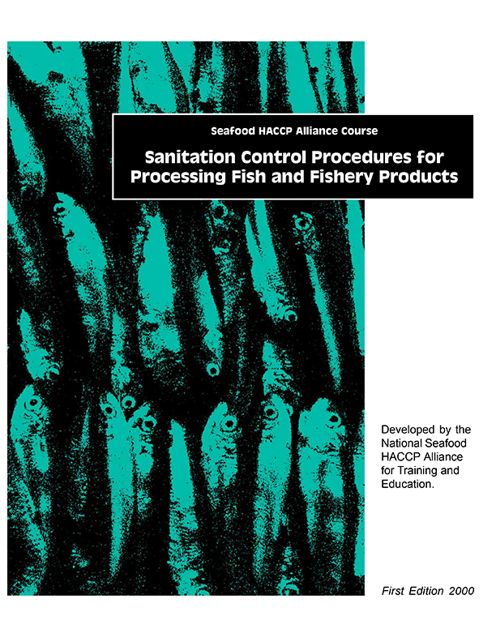
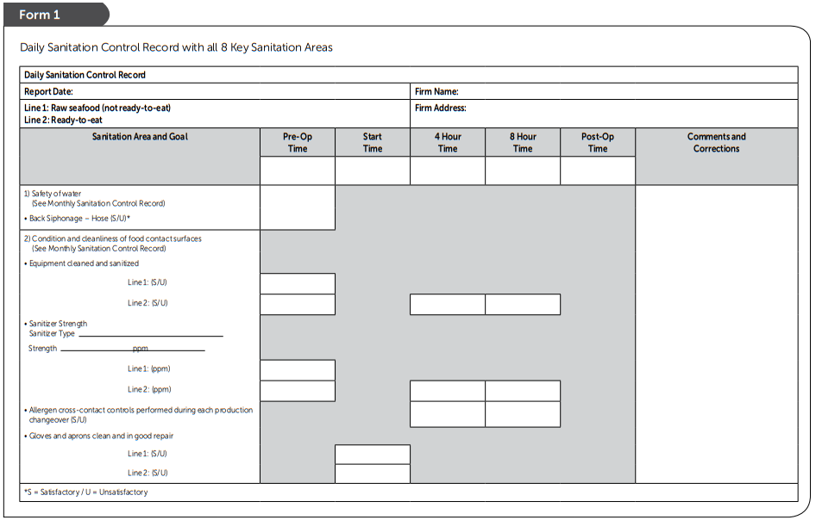
Sanitation Control Procedures (SCPs)
Example of Written Sanitation Standard Operating Procedures (SSOPs) and Records
SCP
Curriculum
SHA Curriculum
GREEN BOOK
BLUE BOOK
SSOP-4 to SSOP-16
CHP 2: 30-40
Source: Florida Sea Grant https://www.flseagrant.org/seafood/haccp/

Slide 15
Good Manufacturing Practices (GMPs)
The new current GMPs (21 CFR Part 117 Subpart B) introduced additional requirements for all seafood processors:
HACCP
SCPs
Appendix 3
GMPs 117
Seafood processors are required to assess and record any necessary
SCP controls to prevent cross-contact resulting in ‘unintended allergen presence’

Slide 16
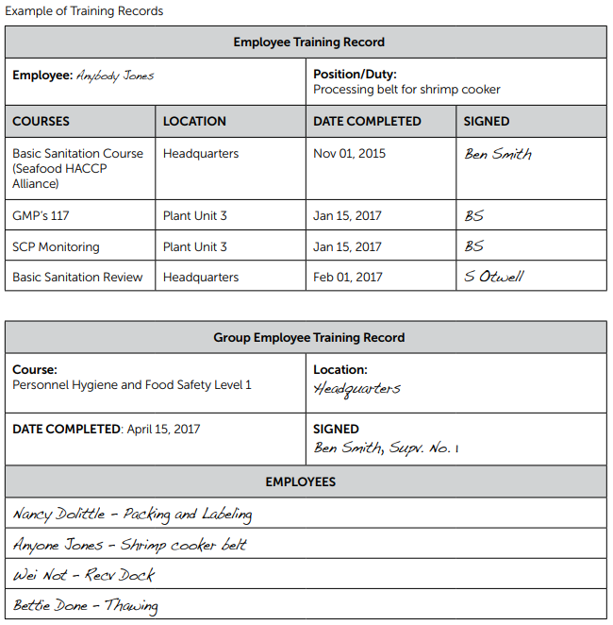
21 CFR Part 117 Subpart A: General Provisions
CHP 2: 13
EMPLOYEE TRAINING RECORDS
Records for additional training are required for all workers in the processing operations
There are no prescribed courses and performance remains the primary measure for effective training, but training records are mandatory

Slide 17
Required parts of a HACCP Program
Shall conduct a Hazard Analysis to determine if there are any significant hazards associated with your products or process.
Develop and implement a HACCP Plan to control any significant food safety hazards that are identified.
HACCP
SCPs
GMPs 117
AD1 - 3

Slide 18
HACCP Plan Requirements
Each of the 7 principles of HACCP has a section in the FDA regulation with specific requirements related to that principle.
HACCP Plans must be specific for:
  Each kind of fishery product (products can be grouped if hazards, processing steps & controls are the same)
  Each processing location
HACCP Plans must list all the required components (CCP, significant hazard, CL, monitoring, corrective actions, record-keeping, verification).
HACCP Plans must be signed, dated & routinely implemented.
AD1-4

Slide 19
Review of 7 HACCP Principles
Conduct a Hazard Analysis:
Principle 1 – Conduct a Hazard Analysis
Principle 2 – Identify Critical Control Points
Build a HACCP Plan
Principle 3 – Set Critical Limits
Principle 4 – Establish Monitoring Procedures
Principle 5 – Establish Corrective Action Procedures
Principle 6 – Establish Verification Procedures
Principle 7 – Establish a Record Keeping System

Slide 20
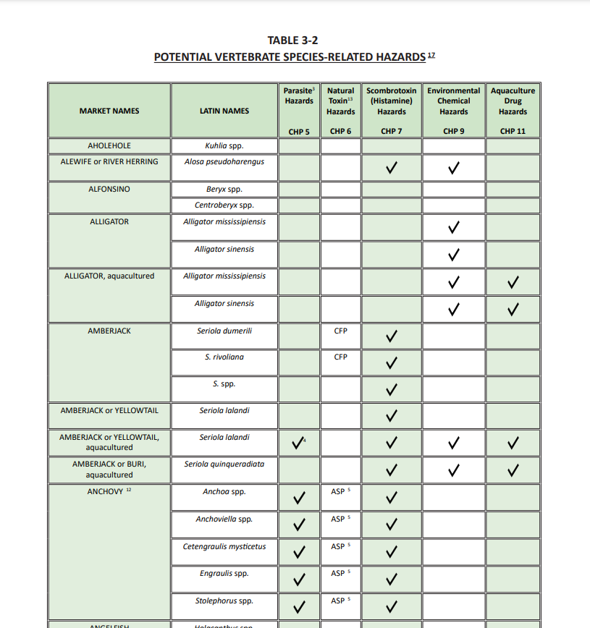
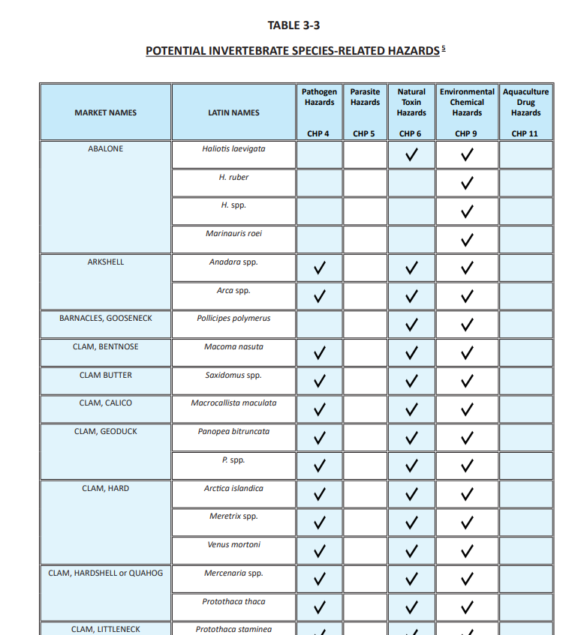
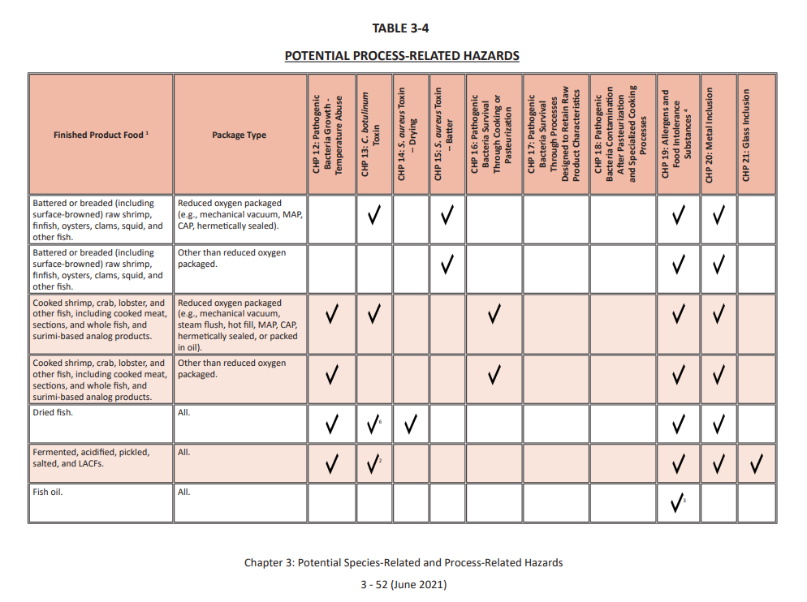
Principle 1: Conduct a Hazard Analysis
Identify and List all potential food safety hazards associated with the product and process.
Species Hazards
Process Hazards
Pathogens from Harvest Area
Parasites
Natural Toxins
Scombrotoxin (Histamine)
Other Decomposition-related Hazards (Biogenic amines)
Environmental Chemicals
Methyl Mercury
Aquaculture Drugs
12. Pathogen Growth & Toxin Formation
13. C. botulinum Growth & Toxin Formation
14. Pathogen Growth & Toxin Formation inadequate
drying.
15. S. aureus Toxin Formation in hydrated batters
16. Pathogen Growth & Survival through cooking
17. Pathogen Survival through process designed to retain
raw characteristics
18. Intro. of Pathogens after pasteurization and specialized cooking
19. Allergens & Food Intolerance Substances/ADDITIVES
20. METAL
21. Glass Inclusion
CHP 5: 77
CHP 3: 3-1

Slide 21
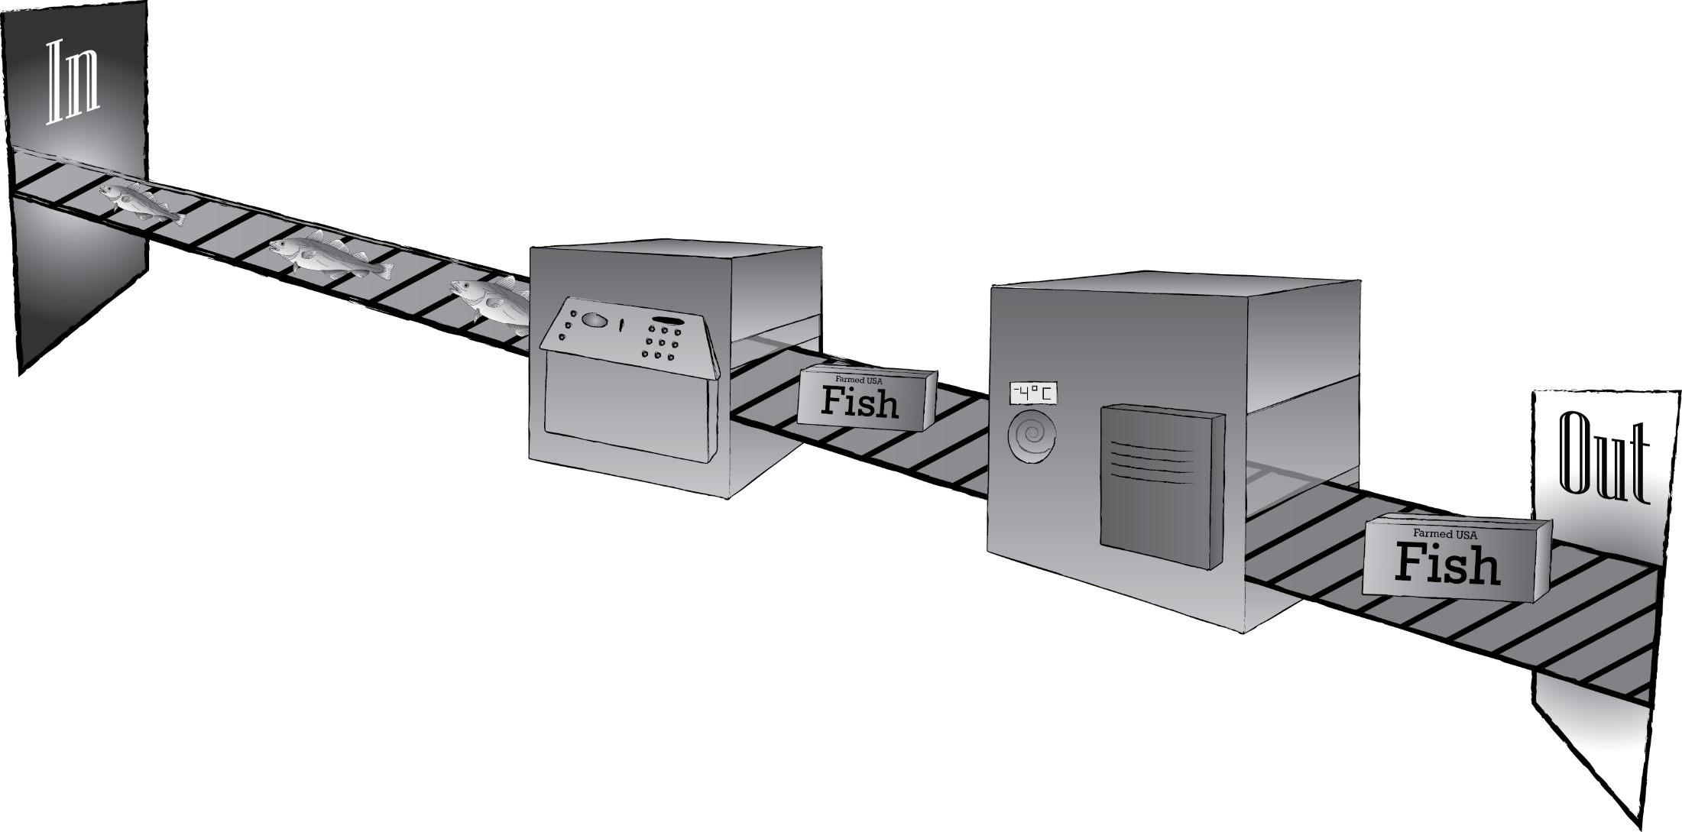

Principle 2: Identify Critical Control Points (CCPs)
Identify what processing steps can be used to control the significant hazards.
CHP 2: 25
Receiving
Refrigerated Storage
Packaging
CHP 6: 99
Processing

Slide 22
Principle 3: Set Critical Limits
Critical limits specify the maximum and/or minimum value to which a parameter (temperature, time) must be controlled at a CCP.
CHP 7: 109
Received from approved supplier with documentation to control aquaculture drugs
Label with species name must be present to control allergens
Temperature not to exceed 40°F to prevent pathogen growth
CHP 2: 26
Not to exceed 1 hour to prevent pathogen growth

Slide 23

Principle 4: Establish Monitoring Procedures
Determine what will be monitored, how it will be monitored, when it will be monitored and by who.
When: Continuously by logger and initialed 1x daily
CHP 8: 119
What: Temperature
CHP 2: 26
How: Temperature Logger
Who:
QA Manager

Slide 24

Principle 5: Establish Corrective Actions
Determine what you will do if your critical limits are not met.
CHP 5: 129
CHP 2: 27
Then: Move product to a working refrigerator and hold for testing
AND
Fix the broken refrigerator
If: Temperature exceeds 40°F.

Slide 25
Principle 6: Establish Verification Procedures
CHP 2: 28
CHP 10: 141
Implement procedures for validating that your HACCP plan is working properly.
HACCP Plan Assessment
Process validation
Equipment calibration
Equipment accuracy checks
Targeted sampling and testing for product safety
Review of calibration, monitoring, corrective actions records

Slide 26
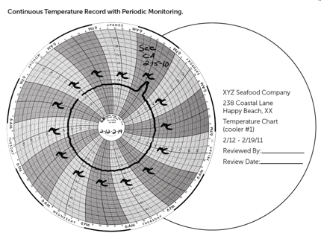
Principle 7: Establish a Record Keeping System
CHP 2: 27
CHP 11: 157
Tracks all monitoring procedures, corrective actions and verifications of your system to ensure standards are met and facility is in compliance.
Form Title: Refrigerator Temperature Log (Monitoring Record)
Firm Name: |  |  |  | Firm Location:
Production Identification:
Critical Limits: |  |  | Monitoring Activities:
Date | Time | Storage Unit # | Refrigerator Temperature |  | Critical Limit Met (Yes/No) | Line Operator (Initials)
Reviewer Signature: |  |  |  |  | Date of Review:

Slide 27
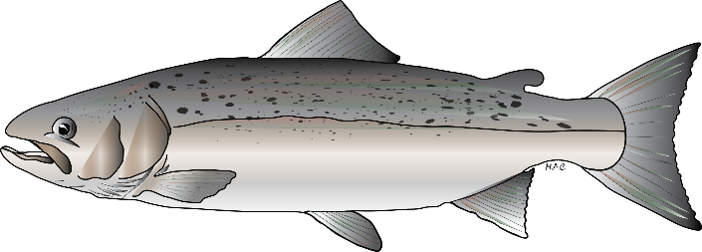
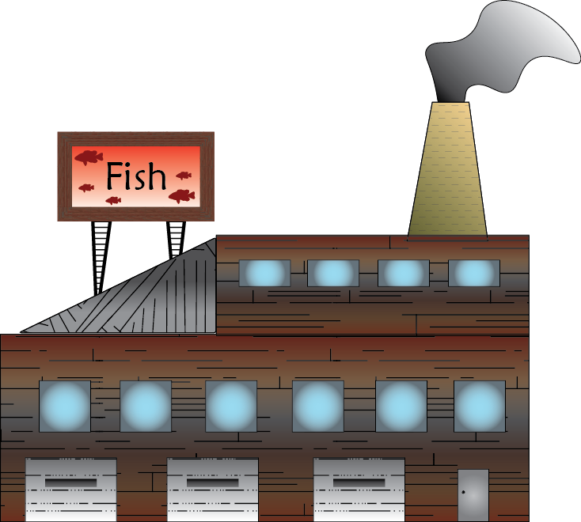
Potential Seafood Safety Hazards
Species-Related Hazards
Seafood
Process-Related Hazards

Slide 28
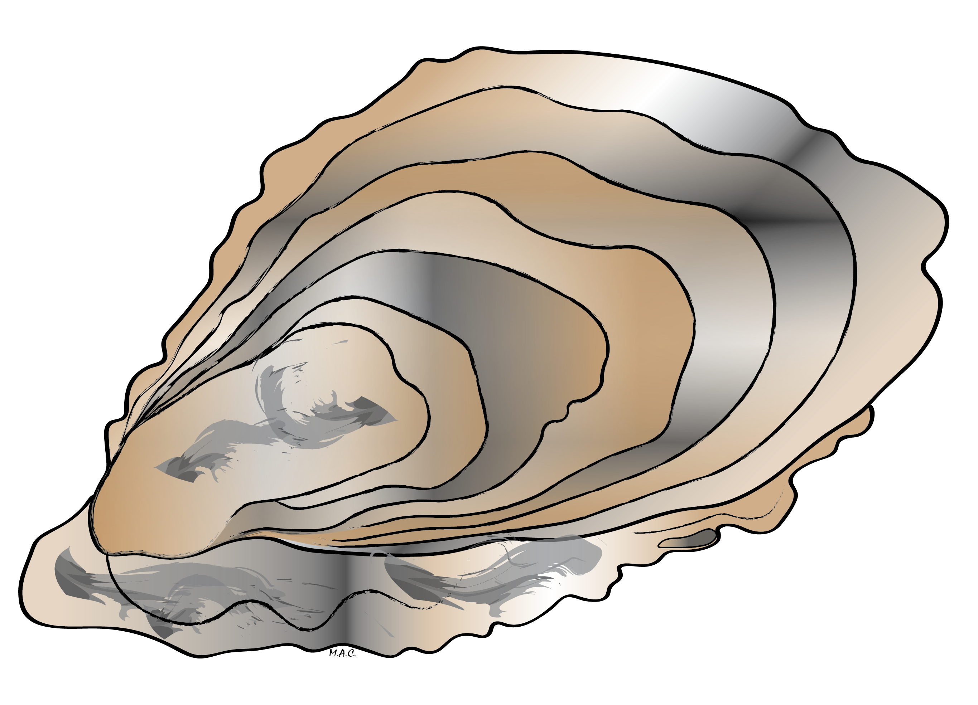
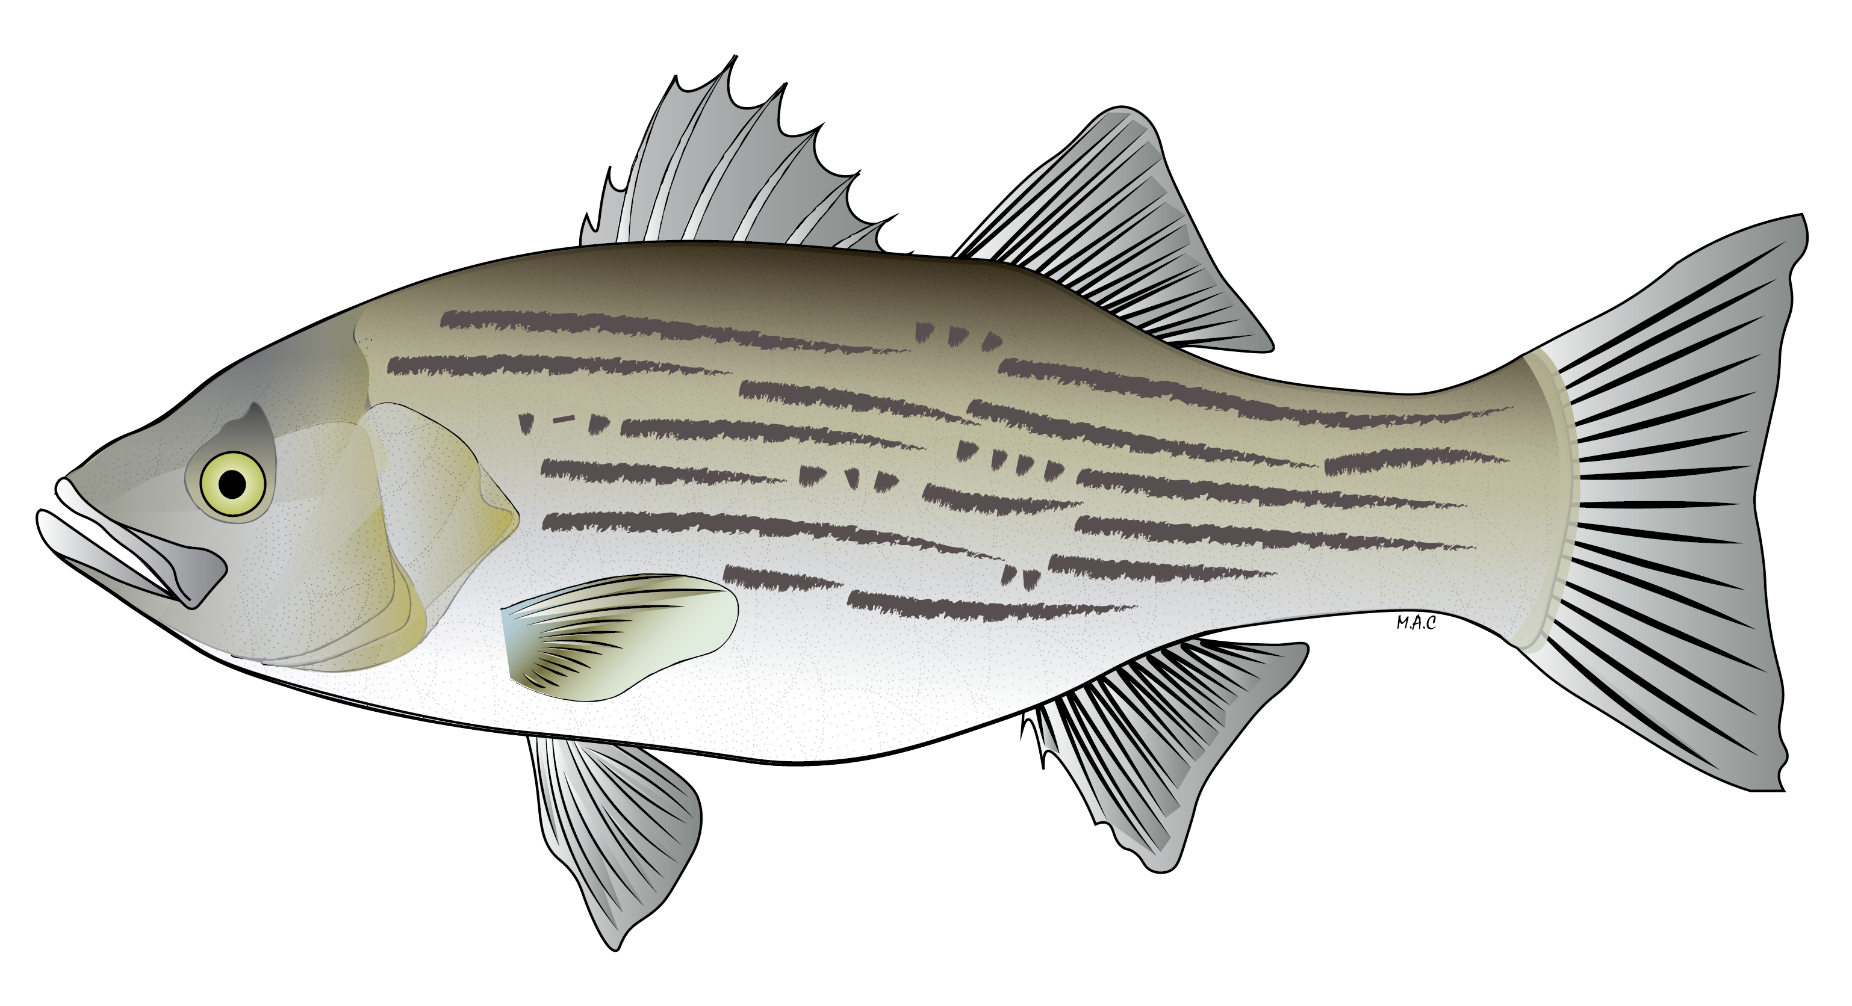
Potential Seafood Hazards
SPECIES-Related Hazards
Invertebrate
Table 3-3: 3-40
Pathogens (harvest)
Parasites
Natural Toxins
Histamine
Environmental Chemicals
Aquaculture Drugs
Vertebrate Table 3-2: 3-3

Slide 29
Potential Seafood Hazards
SPECIES-Related Hazards
Vertebrate Table 3-2: 3-3
Invertebrate
Table 3-3: 3-40

Slide 30
Potential Seafood Hazards
Seafood
Process-Related Hazards
Pathogen Bacteria Growth
– Temperature Abuse
C. botulinum Toxin
S. aureus Toxin – Drying
S. aureus Toxin – Batter
Pathogen Bacteria Survival through Cooking and Pasteurization
Pathogen Bacteria Survival through Processes Designed to Retain Raw Product Characteristics
Pathogenic Bacteria Contamination after Pasteurization and Specialized Cooking Processes
Allergens and Food Intolerance Substances
Metal Inclusion
Glass Inclusion

Slide 31
Potential Seafood Hazards
Seafood
Process-Related Hazards
Table 3-4:
3-52

Slide 32
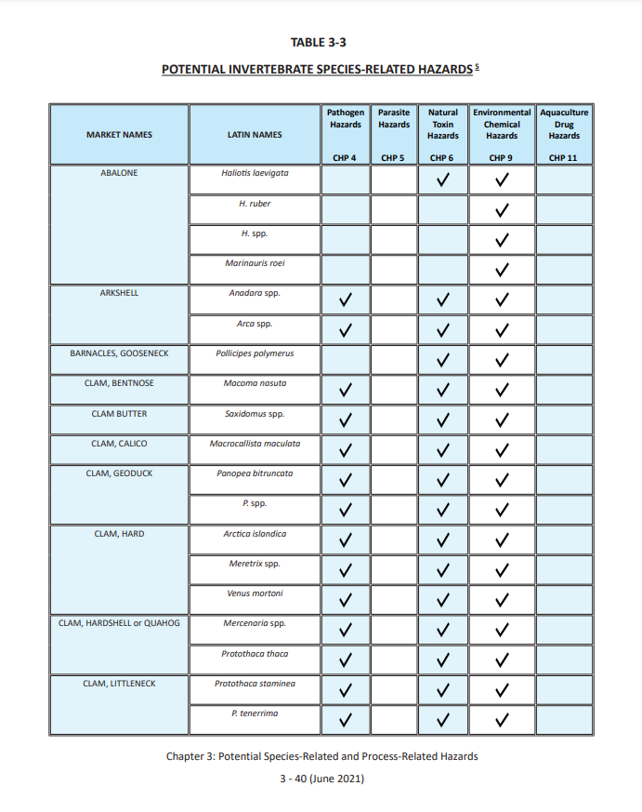
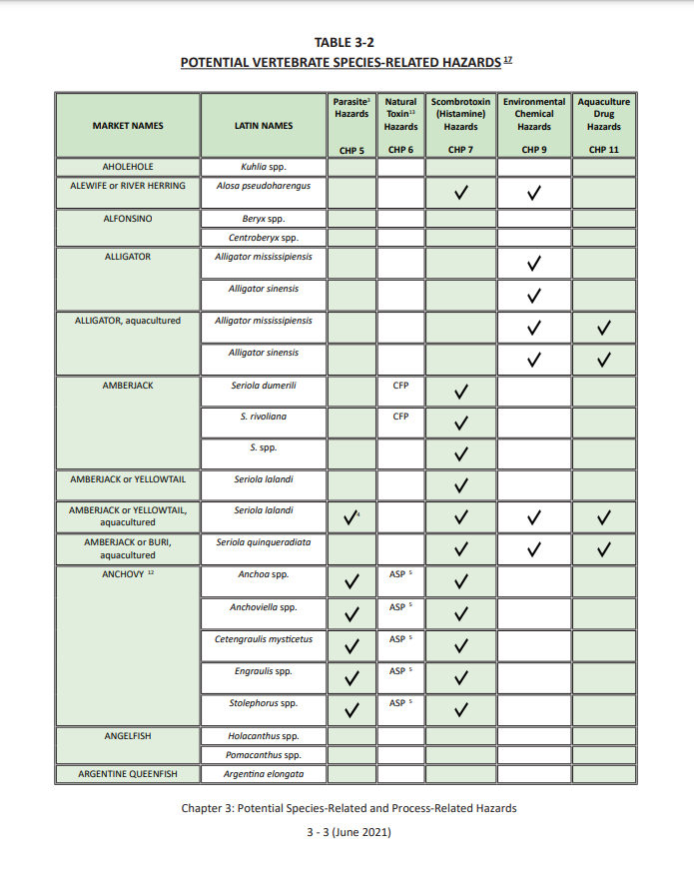
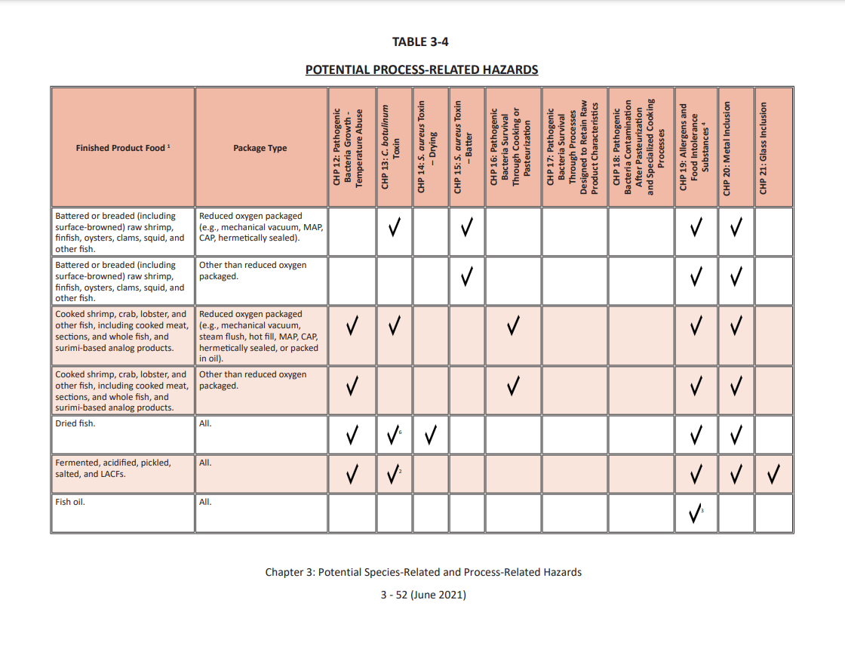
Review of Potential Seafood Hazards
Species-Related Hazards
Process-Related Hazards

Slide 33
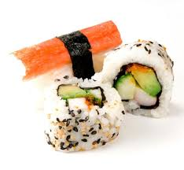
Species-Related Food Safety Hazards
CHP5: 91
Parasites:
Hazard: Living parasites in certain fish or shellfish species that can infect humans.
Controls: Cooking or proper freezing.
HACCP Controls: A processor must properly freeze products that are likely to contain parasites if they will be consumed raw or partially cooked (e.g., sushi, sashimi, cold smoked, pickled, etc.).

Slide 34
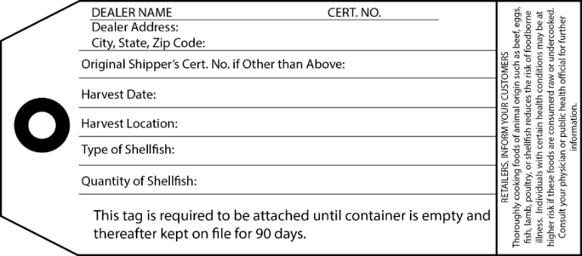
Species-Related Food Safety Hazards
CHP4: 75
Harvest Pathogens:
Hazard: Harvest waters can have high pathogen levels that contaminate shellfish or some fish.
Controls: Cooking or restricting harvesting to approved waters with safe pathogen levels.
HACCP Controls: Bivalve molluscan shellfish are only harvested from approved waters and all processors ensure
products are properly tagged or labelled to
ensure traceability.
Notes:
Instructors should reference NSSP Guide as shellfish hazards and controls are not specifically covered in the Hazards Guide.
Instructor’s note should add that cooking will not eliminate toxins or environmental chemicals.

Slide 35
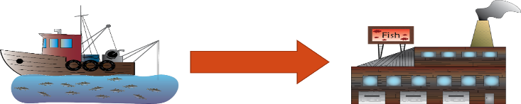
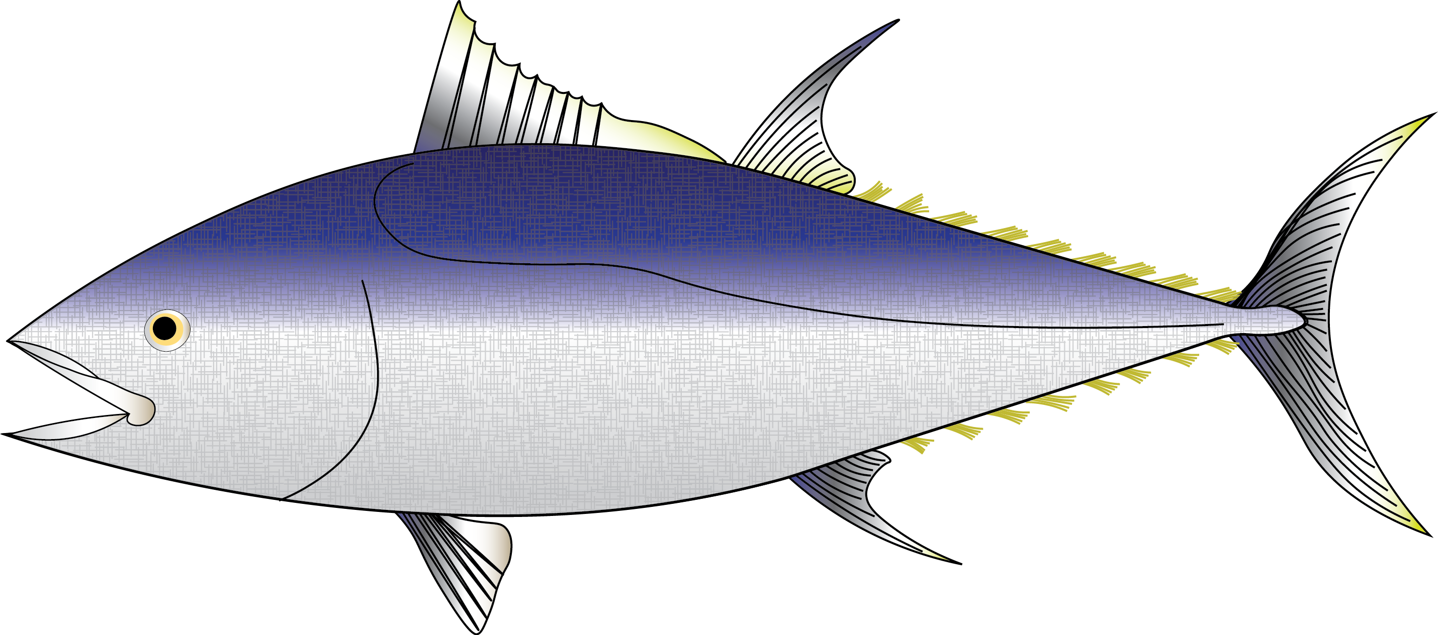
Species-Related Food Safety Hazards
Histamine or Scombrotoxin:
Hazard: Elevated histamine levels can develop in certain fish species exposed to time and temperature abuse.
Controls: Prevent time and temperature abuse in fish species likely to develop scombrotoxin.
HACCP Controls: All processors must keep fish chilled and limit exposure times to unrefrigerated temperatures.
CHP7: 113

Slide 36
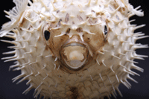
Species-Related Food Safety Hazards
Natural Toxins:
Hazard: Naturally occurring toxins can accumulate in shellfish and finfish harvested from contaminated waters.
Controls: Prohibit harvesting from contaminated waters.
HACCP Controls: Primary processors must confirm that the products they receive were not harvested from contaminated waters.
CHP6: 6 - 1

Slide 37

Species-Related Food Safety Hazards
Environmental Chemical Pollutants/Contaminants:
Hazard: Environmental or industrial chemicals can accumulate in finfish or shellfish harvested from polluted waters.
Controls: Prohibit harvesting from contaminated waters.
HACCP Controls: Primary processors must confirm that the products they receive were not harvested from waters that have a health advisory because of pollution.
CHP9: 155

Slide 38
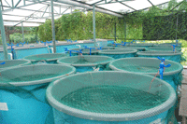
Species-Related Food Safety Hazards
CHP11: 11 - 1
Aquaculture Drugs:
Hazard: Drugs used in aquaculture facilities must be approved by FDA and properly used.
Controls: Prohibit use of unapproved drugs and follow expert advice on proper use of approved drugs.
HACCP Controls: Primary processors must confirm that the products they receive from aquaculture suppliers are following Good Aquaculture Practices, including following drug usage instructions and FDA requirements.

Slide 39
Potential Seafood Hazards
Species-Related Hazards
Process-Related Hazards

Slide 40
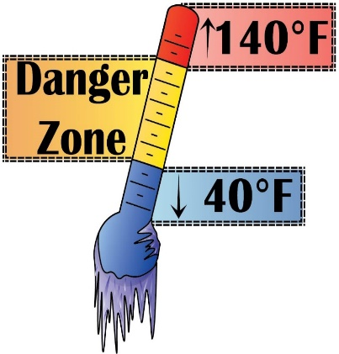
Process-Related Food Safety Hazards
Pathogen Growth caused by time/temperature abuse:
Hazard: Pathogen growth in products that will not be cooked before they are consumed could cause consumer illness.
Controls: Prevent time and temperature abuse of ready-to-eat products (e.g., smoked products, cooked or pasteurized products, salads, sushi).
HACCP Controls: All processors must keep ready-to-eat products adequately chilled and strictly limit exposure times to unrefrigerated conditions.
CHP12: 209

Slide 41
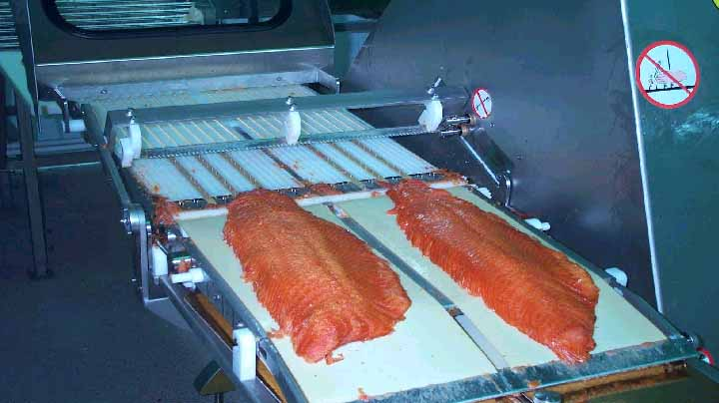
Process-Related Food Safety Hazards
Clostridium botulinum toxin production:
Hazard: C. bot can grow in smoked, salted, & pickled products and products packed in reduced oxygen packages (ROP) that are subjected to time and temperature abuse.
Controls: Ensure that adequate secondary barriers
(e.g., pH, water activity) are in place and prevent exposures
to unsafe times and temperatures.
HACCP Controls: All processors must use validated smoking, drying, salting, pasteurization and pickling procedures that are supported by scientific studies and that are adequately implemented; prevent time and temperature abuse; and use Time Temperature Integrators (TTI) when adequate secondary barriers are not in place or when products require more stringent storage controls.
CHP13: 245

Slide 42
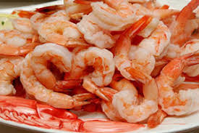
Process-Related Food Safety Hazards
Staph. aureus toxin production:
Hazard: S. aureus can grow in products where competing bacteria have been reduced or eliminated such as cooked, battered, and salted products that are subjected to time and temperature abuse.
Controls: Prevent time and temperature abuse.
HACCP Controls: Processors must keep batters refrigerated and products chilled during and after processing steps where competing bacteria have been eliminated, strictly limiting exposure times to unsafe temperatures.
CHP15: 309

Slide 43
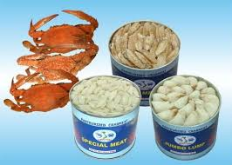
Process-Related Food Safety Hazards
Cooking, Pasteurization and Non-thermal Processes:
Hazard: Improperly cooked, pasteurized or non-thermally processed foods can contain pathogens and cause consumer illness
Controls: Scientifically validated cooking, pasteurization, or non-thermal processes must be used to kill all pathogens
HACCP Controls: Processors must continuously monitor their cooking, pasteurization, or non-thermal processes to ensure that pre-determined validated limits have been met
CHP16: 315

Slide 44
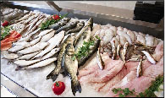
Process-Related Food Safety Hazards
CHP19: 19 - 1
Undeclared Food Allergens:
Hazard: All finfish and crustaceans are considered
a major food allergen. Additional ingredients can
introduce allergens.
Controls: Finfish and crustaceans products and seafood products that contain allergens must be labeled with their correct market name for the species in addition to any other allergenic ingredients in accordance with FALCPA requirements.
HACCP Controls: Processors must ensure that all containers or packages that contain fish, crustaceans, or other allergenic ingredients declare the presence of all allergens.

Slide 45
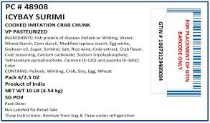
Process-Related Food Safety Hazards
CHP19: 19 - 3
Food Intolerance Substances:
Hazard: Sulfites and some coloring agents can cause a food intolerance reaction in sensitive consumers
Controls: Products that contain food intolerance substances must be properly labeled to alert consumers
HACCP Controls: Processors must ensure that products that contain food intolerance substances are properly labeled

Slide 46
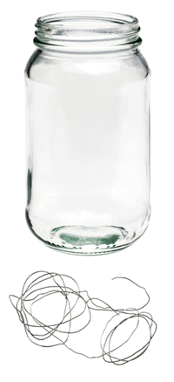
Process-Related Food Safety Hazards
CHP20: 385
Metal Inclusion in finished products:
Hazard: Undetected metal fragments in food can cause injury to consumers.
Controls: Metal detection when it is likely that manufacturing could introduce metal fragments into the food or equipment checks to identify when metal fragments may have been introduced.
HACCP Controls: Processors either implement controls to detect metal fragments or identify when breakage of equipment may have introduced metal fragments into the food.

Slide 47
Process-Related Food Safety Hazards
Glass inclusion in finished products:
Hazard: Undetected glass fragments in food can cause physical injury to consumers.
Controls: Glass containers are inspected and cleaned to prevent glass contaminating the food. Or work areas are inspected to identify when glass breakage has occurred.
HACCP Controls: Processors must inspect glass containers to detect breaking, cracking or other types of glass contamination to ensure that contaminated products are not sold. Or inspect the processing area around lines for broken glass to identify when contamination may have occurred.
CHP21: 395

Slide 48
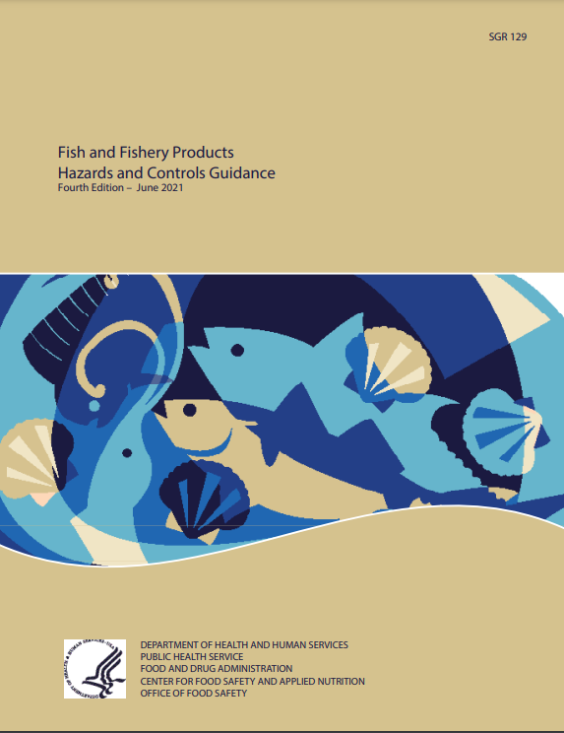
Seafood Hazards & Controls
Each ‘potential’ seafood safety hazard and recommendations for respective control options are briefly explained in the FDA Guide:
FDA GUIDE
How processors can determine which ‘potential’ hazards should be considered for their species and products.
How the hazards and controls can vary for primary and secondary processors.
GOLD BOOK
GOLD BOOK

Slide 49
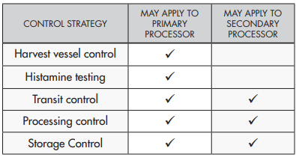
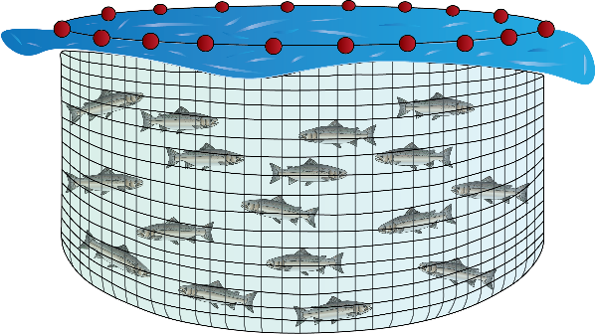
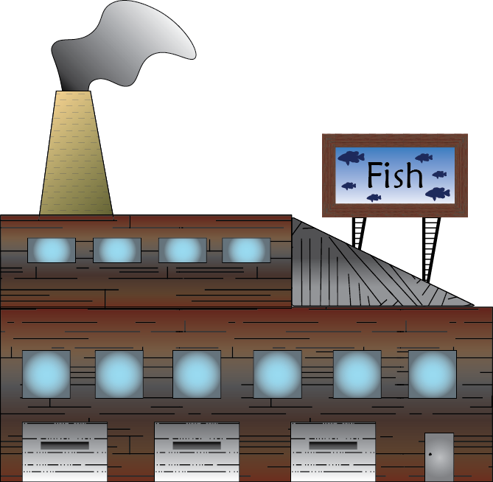
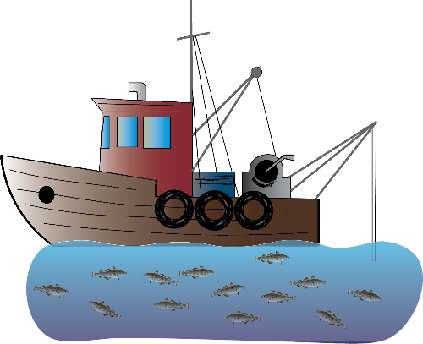
In HACCP regulations processors are responsible for Hazard Controls, so it is important to understand the difference between primary and secondary processing
NOTE
CHP 7: 125
Seafood
Seafood
WILD
Primary Processor: first receiver from the fisherman or fish farm
Secondary Processor: receives products from other processors
FARMED

Slide 50
Controlling Hazards
Once a processor identifies a hazard – species or process-related, they must implement a control strategy to control the hazard
CHP 7: 125

Slide 51
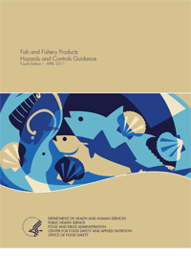
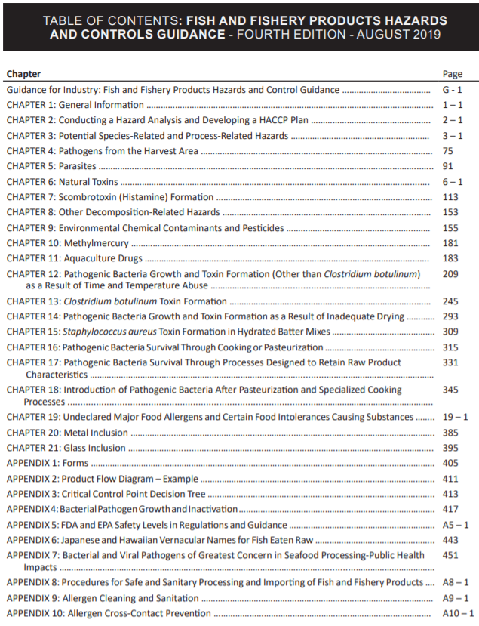
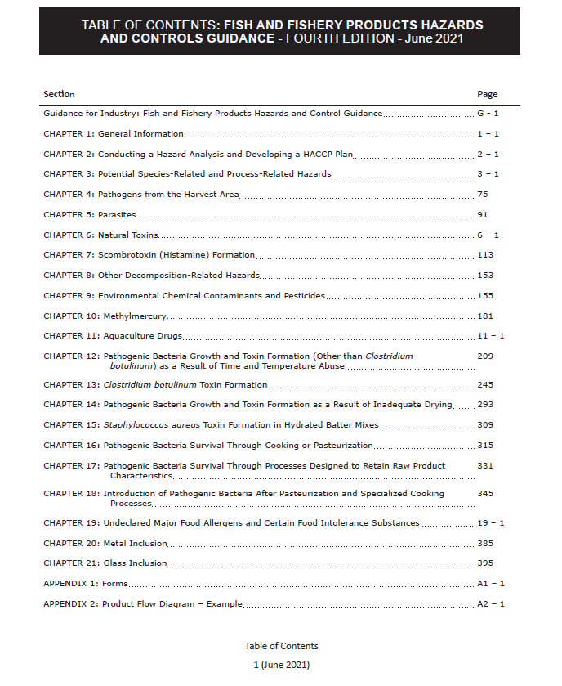
Chapter Structure and Content
Understand the Potential Hazard
Determine whether the hazard is significant
Identifying CCPs
Develop a Control Strategy
  Set Critical Limits
  Establish Monitoring Procedures
  Corrective Actions
  Establish a Recordkeeping System
  Establish Verification Procedures
  Example HACCP Plan(s)
  Bibliography

Slide 52

Developing a HACCP Program
Hazard Analysis =
CCPs
HACCP Plan =

Slide 53
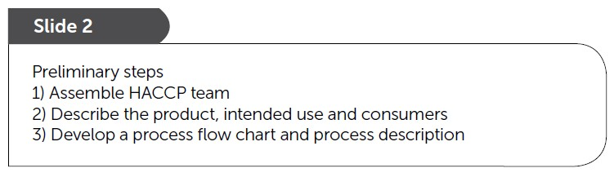
Building the HACCP Plan
The Blue Book provides an example for how to develop a HACCP Plan and its preliminary steps
SHA Curriculum
CHP4:69 Mahi-mahi Fillets
BLUE BOOK
BLUE BOOK

Slide 54
Building the HACCP Plan
The Segment 2 course will explain how the HACCP plan was developed using the recommendations in the
FDA Guide
FDA GUIDE
GOLD BOOK
GOLD BOOK

Slide 55
Preliminary Step 1. Assemble the HACCP Team
Managers
Sanitation
Processing
CHP4: 74

Slide 56
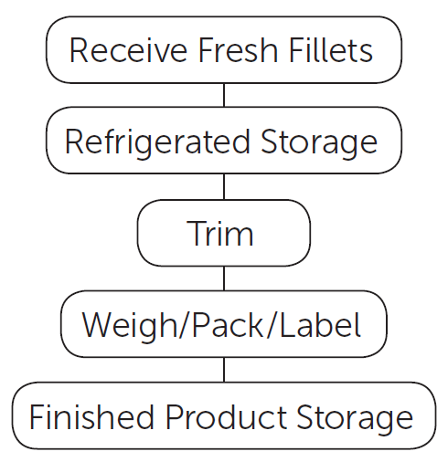
Preliminary Step 2. Process Flow Chart
Develop a Process Flow Diagram and understand or describe what happens at each step (Process Narrative)
Example: Fresh Mahi-mahi fillets
CHP4: 75

Slide 57
A brief processing narrative can be used to help explain the Processing Flow Chart (1 of 2)
Receive Fresh Fish – Fresh wild-caught mahi-mahi (Coryphaena species, not aquacultured) fillets are received from several domestic suppliers (processors). Delivery truck transit times range from 2 to 8 hours. Tubs or other containers of mahi-mahi fillets are received along with other fresh seafood products packed in ice and delivered by refrigerated truck. After receipt, products are re-iced if necessary and moved into refrigerated storage.
Refrigerated Storage – Individual mahi-mahi fillets are completely buried in ice and stored in a refrigerated cooler until needed.
Trim – Individual tubs or containers of mahi-mahi fillets are removed from the cooler as needed to pack customers’ orders. Fillets are trimmed by hand with knives if necessary to meet customer specifications. Trimming is completed in 30 minutes or less.
CHP4: 75-76

Slide 58
A brief processing narrative can be used to help explain the Processing Flow Chart (2 of 2)
CHP4: 75-76
Weigh/Pack/Label – Per customer order, mahi-mahi fillets are weighed, packed into containers, and each container is labeled with a handwritten or printed label that contains the market name of the species of fish that it contains. Individual containers are completely surrounded by ice and assembled into master cartons for each customer order. The weigh/pack/label steps are completed in 30 minutes or less.
Finished Product Storage – Containers of iced mahi-mahi fillets are placed in master cartons that contain each customer’s order and are placed back into refrigerated storage until it is moved directly to refrigerated trucks for delivery to retail or restaurant customers.

Slide 59
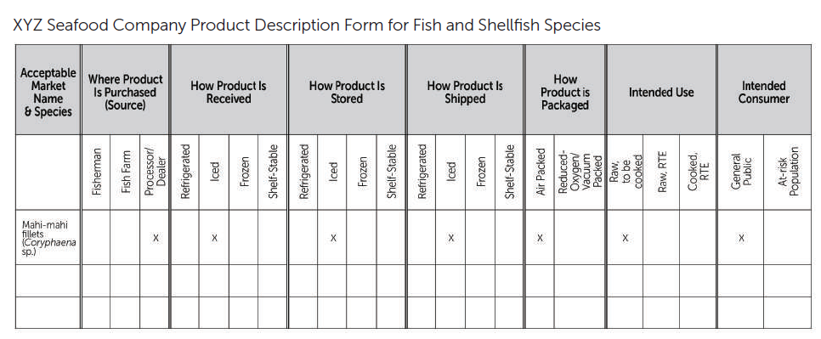
Preliminary Step 3. Describe Product
CHP4: 74
Blue Book provides a useful form
for preliminary information
Appendix 2

Slide 60
Required Hazard Analysis
Use the preliminary information
  Process Description
  Processing Flow Chart
  Accompanying process narrative
FDA GUIDE
with recommendations from the
FDA Guide beginning with a
Hazard Analysis Worksheet
Appendix 2
GOLD BOOK
GOLD BOOK

Slide 61
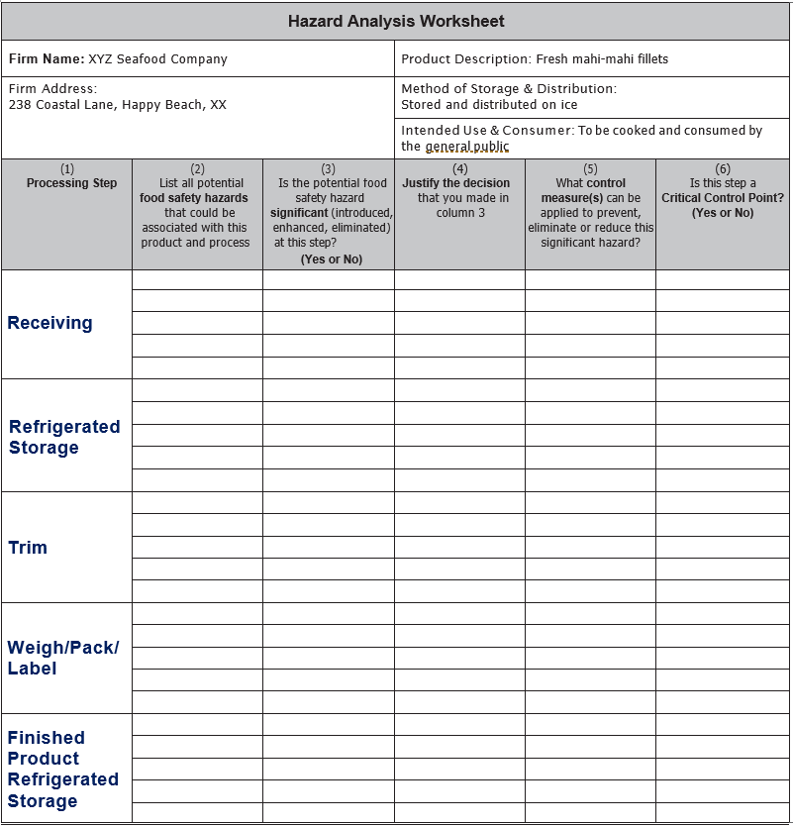
Hazard Analysis
Worksheet
Receiving
Step
Refrigerated
Storage
Step
Column 1: List all of the processing steps from the Process Flow Chart
Trim
Step
Weigh/Pack
Label Step
Final
Refrigerated
Storage
Step

Slide 62
Use the FDA Hazard Guide to help identify the potential hazards for analysis
AD1-3
“… guidance describes the Agency’s current thinking on a topic and should be viewed only as recommendations …”
Recommendations lead to
successful compliance
FDA GUIDE
GOLD BOOK
GOLD BOOK

Slide 63
Search for the potential hazards for the Fresh ‘Wild’ Mahi-mahi Fillets (XYZ Seafood Company)
Tables 3-2 and 3-3 Species-Related Hazards
Table 3-4
Process-Related Hazards

Slide 64
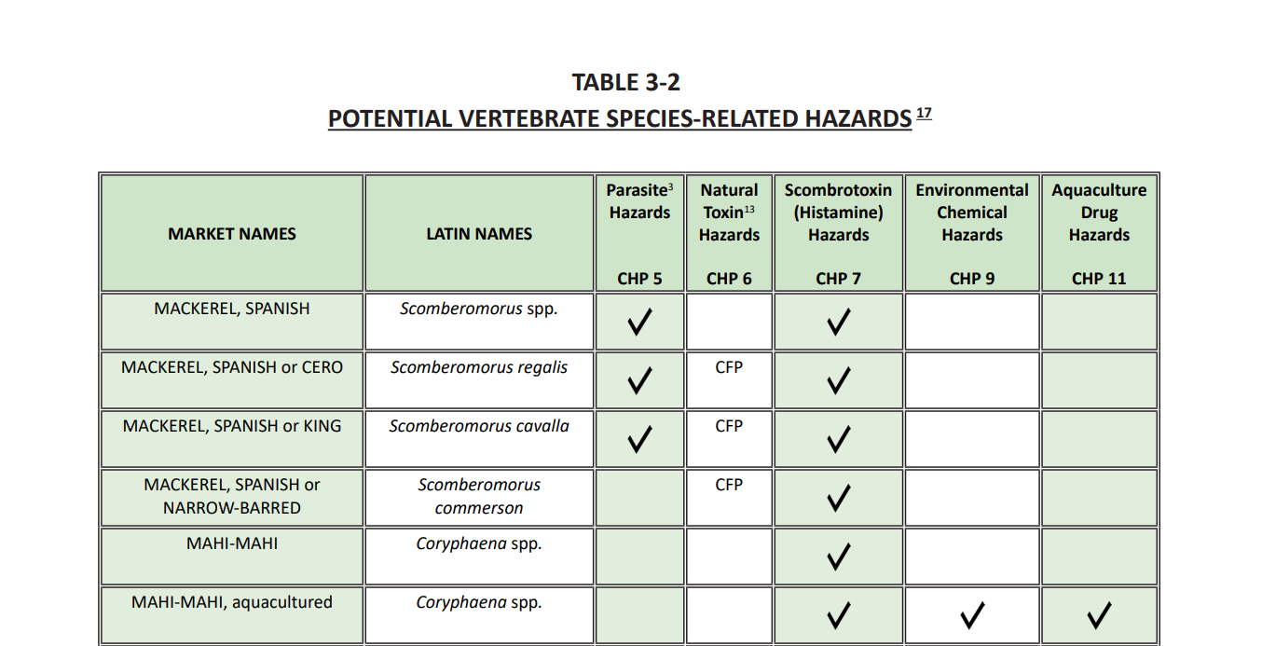
One Species-related hazard
Table 3-2

Slide 65
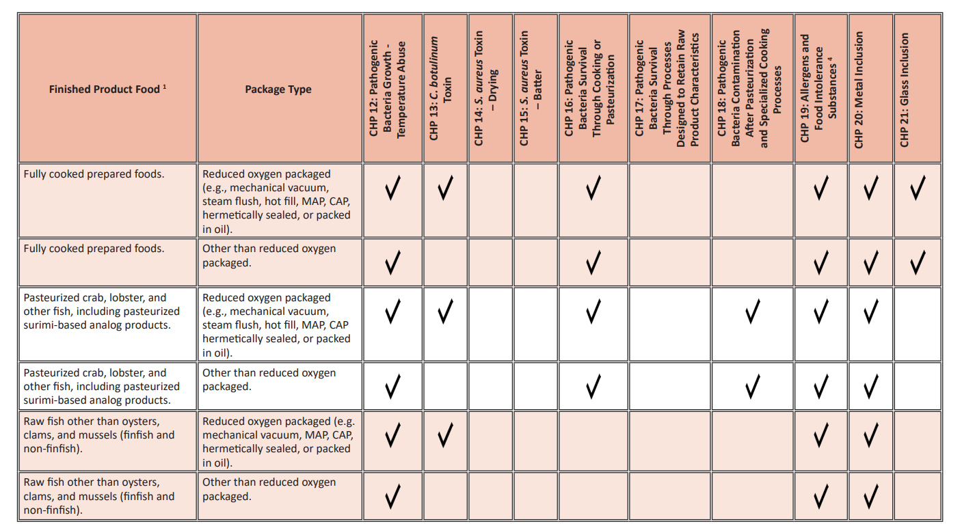
Four Process-related Hazards
Notice two hazards in Chapter 19
Table 3-4

Slide 66
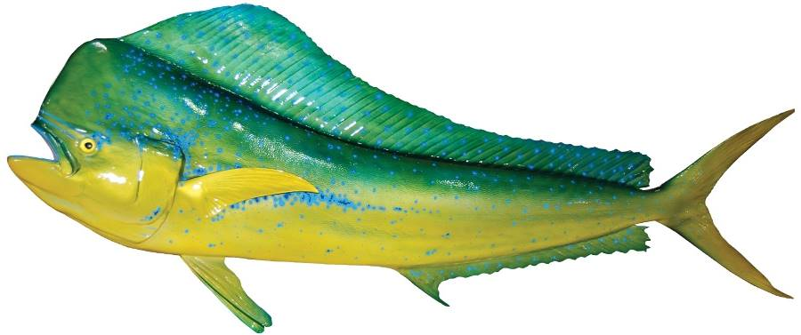
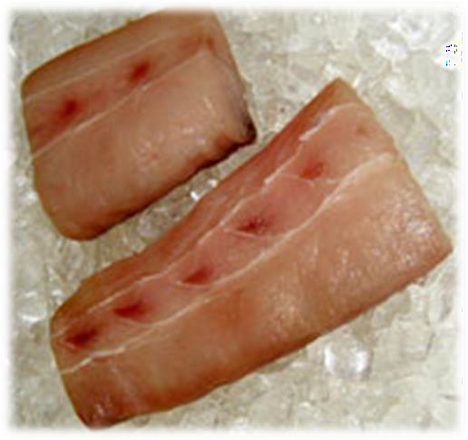
Hazard Analysis for the XYZ Seafood Company should include 5 potential hazards:
Species-related Hazards (Table 3-2)
Histamine formationChapter
Process-related Hazards (Table 3-4)
Pathogenic bacterial growth-temperature abuse
Allergens
Food Intolerance Substances
Metal inclusion
CHP 7
CHP 12
CHP 19
CHP 19
CHP 20

Slide 67
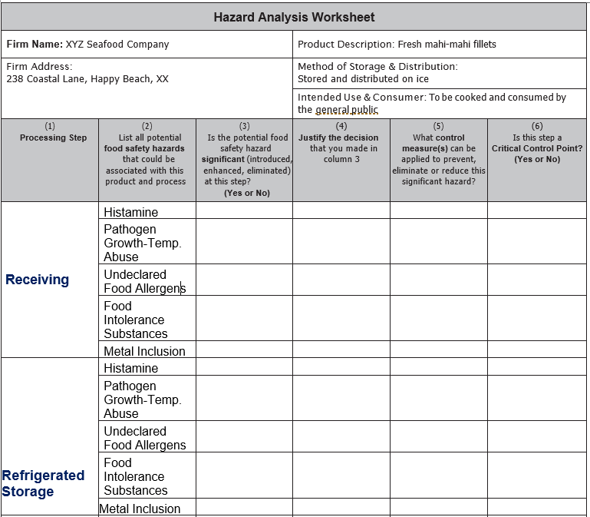

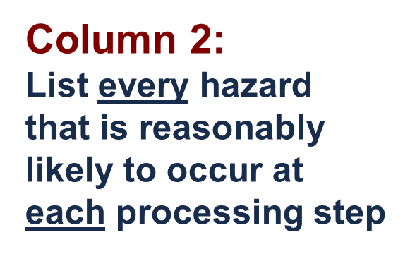
Inclusive
Method
List every potential hazard at each processing step

Slide 68
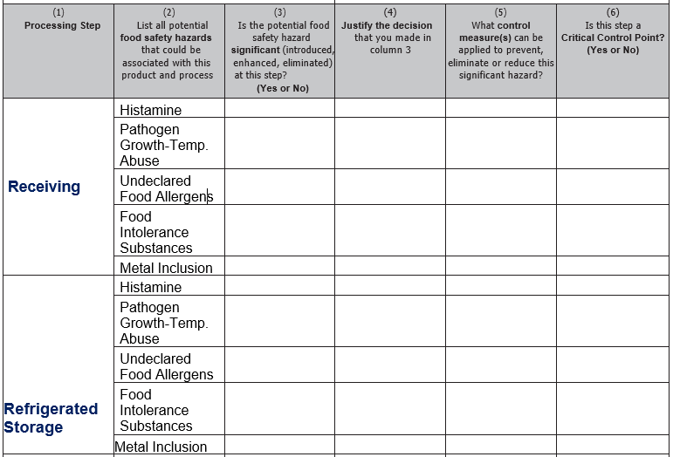

Exercise - Complete the Hazard Analysis Worksheet
Answer the questions, in order, for each listed potential hazard at each processing step using the appropriate chapter of the FDA Guide.
The FDA Guide provides information in the respective hazard chapters to help determine if the hazard is reasonably likely to occur and recommendations for control strategies.

Slide 69
BRIEF SUMMARY based on the FDA Guide that provides more recommended details
Hazard Analysis Worksheet
(1) Processing Steps | (2) List all potential food safety hazards that could be associated with this product and process. | (3) Is the potential food safety hazard significant (introduced, enhanced or eliminated) at this step? (Yes or No) | (4) Justify the decision that you made in column 3 | (5) What control measure(s) can be applied to prevent this significant hazard?
Receive Fresh Fillets | Histamine | Yes CHP7: 121 | If the product does not remain sufficiently chilled, histamine could form | Mahi-mahi fillets are shipped in containers completely surrounded by ice (Proper Icing) CHP7: 123
 | Pathogen Growth due to Temperature Abuse | No CHP12: 214 | Product will be cooked prior to consumption | N/A CHP 12
 | Allergens | Yes CHP19: 19-6 | Fish is one of the top 8 food allergens | Will be controlled at labeling (Proper Labeling) CHP19: 19-7
 | Food Intolerance Substances | No CHP19: 19-6 | No FIS used or added in this processing operation | N/A CHP 19
 | Metal Inclusion | No CHP20: 386 | Not likely to occur at this step | N/A CHP 20

Slide 70

Completed Hazard Analysis Worksheet
Page 1
CCP
Completed
Hazard Analysis
105 - 107
CCP
NOTE: Every ‘Yes’ in column 3 requires a response in column 6

Slide 71

Completed Hazard Analysis Worksheet
Page 2
Completed
Hazard Analysis
105 - 107
CCP
CCP
NOTE: Every ‘Yes’ in column 3 requires a response in column 6

Slide 72
Conclusions from the Hazard Analysis
Histamine is a significant food safety hazard and there are three CCPs for this hazard:
CCP 1. Receive fresh fish
CCP 2. Refrigerated storage, and
CCP 3. Finished product refrigerated storage
Food allergens is a significant food safety hazard and there is one CCP for this hazard:
CCP 4. Weigh/Pack/Label

Slide 73

Building the HACCP Plan
Appendix 2

Slide 74


Optional HACCP Plan Forms
(both must contain same information)
Appendix 2 101 and 102
Portrait
Landscape

Slide 75



Set up a HACCP Plan Form for each CCP
Column 1 & 2: List all of the identified CCPs

Slide 76

Principle 3: Set Critical Limits using the
FDA Hazards Guide
CHP 7: 125
CONTROL STRATEGY
selected from the FDA Guide
CCP – Receiving
Hazard - Histamine
Example 3 CHP 7: 137

Slide 77
Principle 3: Set Critical Limits using the FDA Hazards Guide
TRANSIT CONTROL OPTIONS (Example 3)
Critical limits will depend on how product is received.
Fish delivered refrigerated (not frozen), or
Fish delivered under ice, or
Fish delivered under ice on an open-bed truck, or
Fish delivered under chemical cooling media, or
Fish delivered refrigerated (not frozen) with transit time of 4 hours or less
CHP 7: 137

Slide 78
Principle 3: Set Critical Limits using the
FDA Hazards Guide
TRANSIT CONTROL CRITICAL LIMITS
Transit temperature records, or
Completely surrounded by ice on delivery, or
Use of ice; AND internal fish temperature, or
Frozen gel-packs; AND internal fish temperature, or
Transit time (< 4 hours); AND internal fish temperature
CHP 7: 137
Tip
Notice ‘ORs & ANDs ’

Slide 79

CHP7: 109
Principle 3: Establish CRITICAL LIMITS
Receiving - Transit Control Example 3 - CHP 7: 137
Based on recommendations
in the FDA Guide

Slide 80
Principle 4: Establish Monitoring Procedures
Follow the same option selected for Critical Limits
Example: Control Strategy = Transit control
Critical Limit Option: Surrounded by ice
    What will be monitored?
    How will monitoring be done?
    How often will monitoring be done (frequency)?
    Who will do the monitoring?
CHP 7: 137-139

Slide 81

CHP8: 119
Principle 4: Establish CCP MONITORING
Example 3
CHP 7: 137-139
Based on
FDA Guide

Slide 82
Principle 5: Establish Corrective Actions
Follow the same option selected for Critical Limits
Example: Control Strategy = Transit control
Critical Limit Option: Surrounded by ice
Corrective Actions must cover two parts that include actions to assure safe products and to fix the problem before further processing
CHP 7: 139
82

Slide 83

CHP 9: 129
Principle 5: CORRECTIVE ACTIONS (Page 1 of 2)
Example 3
CHP 7: 139

Slide 84

CHP9: 129
Principle 5: CORRECTIVE ACTIONS (Page 2 of 2)

Slide 85
Principle 6: Establish Verifications
Select the Verification options that apply to the critical limit chosen:
    Weekly record review applies to all options
    Periodic check of internal temperature of fish to ensure ice keeps below 40°F
    Thermometers must be checked for accuracy and periodically calibrated
    Annual Review of HACCP Plan
CHP 7: 139 - 140
85

Slide 86

CHP10: 141
Principle 6: VERIFICATIONS (Page 1 of 2)
Example 3
CHP 7:
139 -140

Slide 87

CHP10:141
Principle 6: VERIFICATIONS (Page 2 of 2)

Slide 88
Principle 7: Establish Record Keeping Procedures
Enter the name of the records that will be kept for that CCP on the HACCP Plan Form
Your Records must be designed to meet the requirements of 21 CFR Part 123.9 to document the results of the Monitoring, Corrective Action, and Verification components of the HACCP Plan
CHP 7: 139
88

Slide 89

CHP11:157
Principle 7: RECORDS (Page 1 of 2)
Example 3
CHP 7: 139

Slide 90

CHP11:157
Principle 7: RECORDS (Page 2 of 2)

Slide 91




Complete HACCP Plan
CHP11: 179-184

Slide 92
HACCP Plans can be built for any Hazard in the same way using the appropriate chapter in the FDA Hazards Guide
Select the Control Strategy that applies to your situation & CCP
Select one or more Critical Limit options for your situation
Follow the same option(s) to determine Monitoring, Corrective Action, Verification and Record keeping procedures
92

Slide 93
Other Resources in the
FDA Hazards Guide
Appendices 1-3 (A1-1, A2-1, & A3-1) Blank Forms, flow diagram, and CCP decision tree.
Appendix 4 (417) Bacterial Pathogen Growth and Inactivation Tables A-1 to A-4.
Appendix 5 (A5-1) FDA & EPA Safety Levels in Regulations and Guidance.
Appendix 9 & 10 (A9-1 & A10-1) Allergen cleaning, sanitation and cross-contact prevention.
Appendix 11 & 12 (A11-1 & A12-1) Approved and unapproved aquaculture drugs.
Addendums 1 & 2 (AD1-1 & AD2-1) Fish and Fishery Products (21 CFR 123) and Control of Communicable Diseases (21 CFR 1240.60) [Formerly Appendix 8] and cGMP Regulation.
93

Slide 94
WORK SESSIONS
Each group will:
Get organized: choose a leader, scribe & presenter
Read and review the Preliminary Steps Handout (product description, process narrative, & process flow chart for the model)
Conduct Your Hazard Analysis:
  Set up a Hazard Analysis Worksheet (fill in heading & Column 1 – enter all process steps from Process Flow Diagram)
  Look up all potential Species & Process Hazards in Tables 3-2, 3-3 & 3-4 in the FDA Hazards Guide and enter results in Column 2
  Determine which potential hazards are significant using Chapters 4-21 of the FDA Hazards Guide and enter results in Columns 3 and 4
  For all significant hazards identify control measures in Column 5
  Determine if each step is a CCP for the significant hazards that you have identified using Chapters 4-21 of FDA Hazards Guide
  Every ‘Yes’ in Column 3 requires a response in Column 6 (Identified CCPs).
94

Slide 95
WORK SESSIONS -continued
Each group will:
Develop a HACCP Plan for each significant hazard at each CCP identified in the Hazard Analysis by completing the following:
  Set up a HACCP Plan Form by filling in company & product information and columns 1 and 2 (CCP and Hazard)
  Identify a Control Strategy and the corresponding Critical Limit using Chapters 4-21 in FDA Hazards Guide and enter result in Column 3
  Complete the HACCP Plan Form by identifying the appropriate monitoring, corrective action, verification and records associated with the Control Strategy that was selected from Chapters 4-21. Enter the results in Columns 4-10 of the HACCP Plan Form
Finalize your group’s results for presentation to the rest of the class and determine who from your group will do the presentation.
95

Slide 96

WORK SESSIONS -continued
Finally, to complete the learning process,
Each group will present results for their Hazard Analysis and HACCP plan for open course discussion
96

Slide 97

QUESTIONS
97

